Slide 1
12.2 Assignment: Term Project
Darius Dinkins
DSC 530
Data Exploration and Analysis
Notes:
Your dataset
A PowerPoint presentation outlining your statistical question/hypothesis
A minimum of 5 variables in your dataset used during your analysis (for help with selecting, the author made his selection on page 6 of your book). Consider what you think could have an impact on your question – remember this is never perfect, so don’t be worried if you miss one (Chapter 1).
Describe what the 5 variables mean in the dataset (Chapter 1).
Include a histogram of each of the 5 variables – in your summary and analysis, identify any outliers and explain the reasoning for them being outliers and how you believe they should be handled (Chapter 2).
Include the other descriptive characteristics about the variables: Mean, Mode, Spread, and Tails (Chapter 2).
Using pg. 29 of your text as an example, compare two scenarios in your data using a PMF. Reminder, this isn’t comparing two variables against each other – it is the same variable, but a different scenario. Almost like a filter. The example in the book is first babies compared to all other babies, it is still the same variable, but breaking the data out based on criteria we are exploring (Chapter 3).
Create 1 CDF with one of your variables, using page 41-44 as your guide, what does this tell you about your variable and how does it address the question you are trying to answer (Chapter 4).
Plot 1 analytical distribution and provide your analysis on how it applies to the dataset you have chosen (Chapter 5).
Create two scatter plots comparing two variables and provide your analysis on correlation and causation. Remember, covariance, Pearson’s correlation, and Non-Linear Relationships should also be considered during your analysis (Chapter 7).
Conduct a test on your hypothesis using one of the methods covered in Chapter 9.
For this project, conduct a regression analysis on either one dependent and one explanatory variable, or multiple explanatory variables (Chapter 10 & 11).
Your code or screenshots of your code
A 250-500-word paper summarizing the following: Statistical/Hypothetical Question
Outcome of your EDA
What do you feel was missed during the analysis?
Were there any variables you felt could have helped in the analysis?
Were there any assumptions made you felt were incorrect?
What challenges did you face, what did you not fully understand?
Submit a link to your repository to the assignment link during the final week of class.

Slide 2
How does video game ratings affect sales?
Data pulled from Kaggle.com
Focuses on video game sales and ratings

Slide 3
Variables in the Analysis
Five variables
Genre – The genre of the video game.
Example: Sports, Racing, Role-Playing etc.
Sales – How many copies have been sold
Global
NA
EU
Critic Score – The average score given by notable publications
User Score – The average score given by users
Publisher – The company that is responsible for the distribution of the software/video game

Slide 4
Histograms
In this dataset, I pulled a multitude of histograms.
Used to explore and ask further questions on data
The variables that I didn’t think were as important, showed clear skews in the data (Publisher counts, Developer Counts
Looking at the Critic and User score Histograms, it showed left skewed distribution (negative distribution)
This furthered my thinking that scores affect video game sales
Outliers included the action Genre and the Electronic Arts Publisher.
Action is considered the most common video game genre.
Includes “Shooters, Action-Adventures, and other generic genres”
Electronic Arts publishes the most games as of 2016
Publishes many different sports games yearly
These outliers likely have no effect on the sales data and are a consequence of companies churning out many different games.

Slide 5
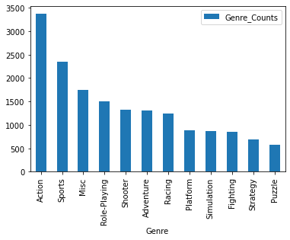
Histogram Genre

Slide 6
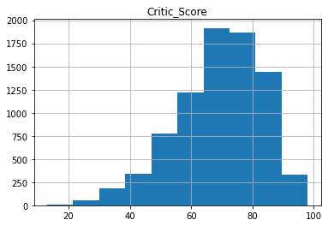
Histograms Critic Score

Slide 7
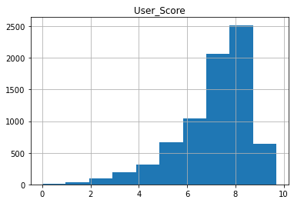
Histograms User Score

Slide 8
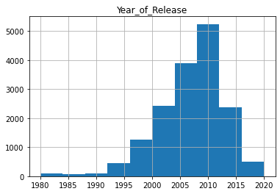

Slide 9
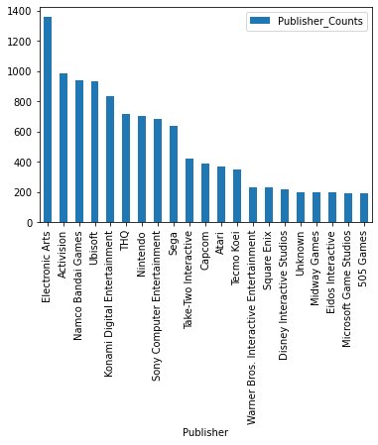
Histogram Publisher Counts

Slide 10
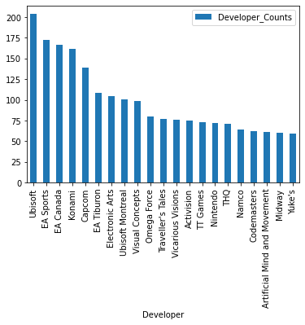
Histogram Developer Counts

Slide 11
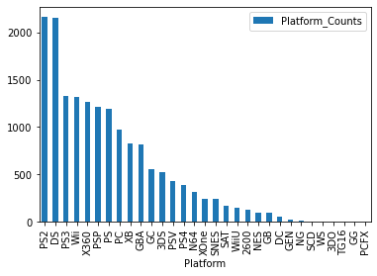
Histogram Platform Counts

Slide 12
Descriptive Characteristics
 | Year_of_Release | NA_Sales | EU_Sales | JP_Sales | Other_Sales | Global_Sales | Critic_Score | Critic_Count | User_Score | User_Count
count | 16448.00 | 16717.00 | 16717.00 | 16717.00 | 16717.00 | 16717.00 | 8137.00 | 8137.00 | 7590.00 | 7590.00
mean | 2006.49 | 0.26 | 0.15 | 0.08 | 0.05 | 0.53 | 68.97 | 26.36 | 7.13 | 162.23
std | 5.88 | 0.81 | 0.50 | 0.31 | 0.19 | 1.55 | 13.94 | 18.98 | 1.50 | 561.28
min | 1980.00 | 0.00 | 0.00 | 0.00 | 0.00 | 0.01 | 13.00 | 3.00 | 0.00 | 4.00
25% | 2003.00 | 0.00 | 0.00 | 0.00 | 0.00 | 0.06 | 60.00 | 12.00 | 6.40 | 10.00
50% | 2007.00 | 0.08 | 0.02 | 0.00 | 0.01 | 0.17 | 71.00 | 21.00 | 7.50 | 24.00
75% | 2010.00 | 0.24 | 0.11 | 0.04 | 0.03 | 0.47 | 79.00 | 36.00 | 8.20 | 81.00
max | 2020.00 | 41.36 | 28.96 | 10.22 | 10.57 | 82.53 | 98.00 | 113.00 | 9.70 | 10665.00

Slide 13
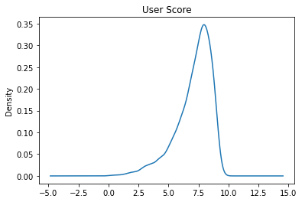
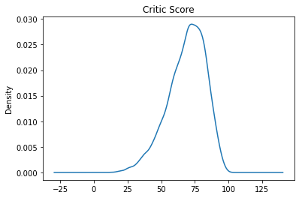
Probability Mass Function (PMF)

Slide 14
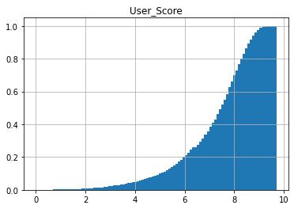
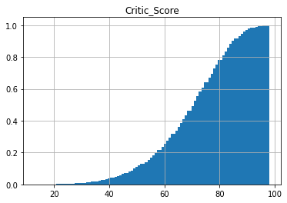
Cumulative Distribution Functions

Slide 15
Cumulative Distribution Functions
What does the CDF tell us about the User Score and Critic Score
It tells us that that the distribution is concentrated in the 60% or above range.
It may show that users and critic are more likely to rate a game if it is above average.
This may have to do with marketing

Slide 16
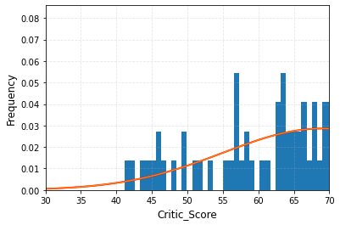
Analytical Distribution

Slide 17
Analytical Distribution
The normal distribution graph tells us that critic score is negatively skewed.
Higher ratings lead to more user engagement.

Slide 18
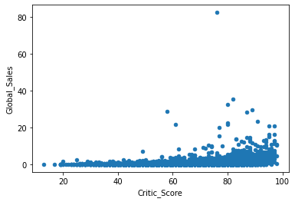
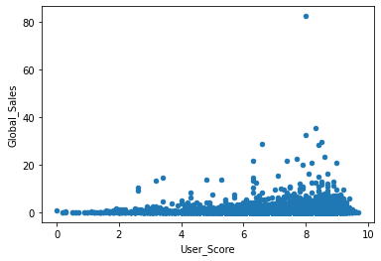
Scatter Plots

Slide 19
Scatter Plots
Scores from both Critic and Users don’t differentiate too much from each other.
Titles with higher scores are more likely to be a hit and have greatly increased sales
Wii Sports is an extreme outlier
The game was bundled with the Wii console and likely contributed to its global sale number

Slide 20
Hypothesis Test
*See notebook for code behind the test
stat=nan, p=1.000
Probably Gaussian

Slide 21
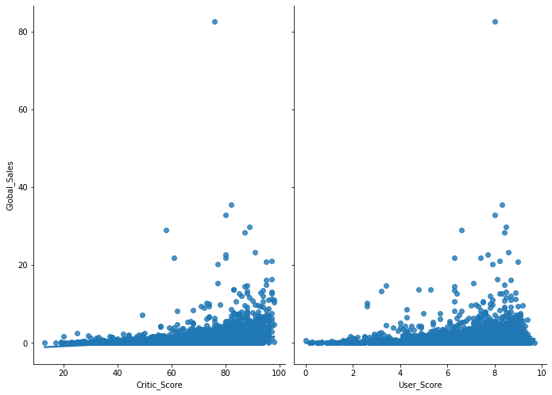
Regression Analysis

Slide 22
References
https://www.kaggle.com/datasets/sidtwr/videogames-sales-dataset?resource=download&select=Video_Games_Sales_as_at_22_Dec_2016.csv
https://www.statista.com/statistics/1263585/top-video-game-genres-worldwide-by-age/
https://www.esrb.org/ratings-guide/

